Slide 1
Bibliographic Ranking in Alma
Yoel Kortick
Senior Librarian

Slide 2

Agenda
Introduction
Viewing the Bibliographic Rank
Searching and retrieving by Bibliographic Rank
How the Bibliographic Rank is determined
The sample record we will use
A real-life example of how the Bibliographic Rank is determined
Future plans for Community Zone Collections
Future plans for Alma Analytics

Slide 3
Introduction

Slide 4
Introduction
Alma evaluates the completeness and richness of MARC 21 bibliographic records based on information that includes identifiers, names, subjects, informative LDR and 008 fields, publication details, etc.
This is reflected in the Bibliographic Rank, meant to provide a helpful tool for libraries to identify records that may need attention.

Slide 5
Introduction
The Bibliographic Rank is displayed in the record view and in the Metadata Editor.
The rank of the records is determined by the Bibliographic Rank Algorithm.

Slide 6
Introduction
The Bibliographic Rank differs from the Brief Level as follows:
  The bibliographic rank is determined by the Bibliographic Rank Algorithm which is the same for every institution including the Community Zone.
  The Brief Level can differ per institution because each institution can customize how the level is determined.

Slide 7
Viewing the Bibliographic Rank

Slide 8
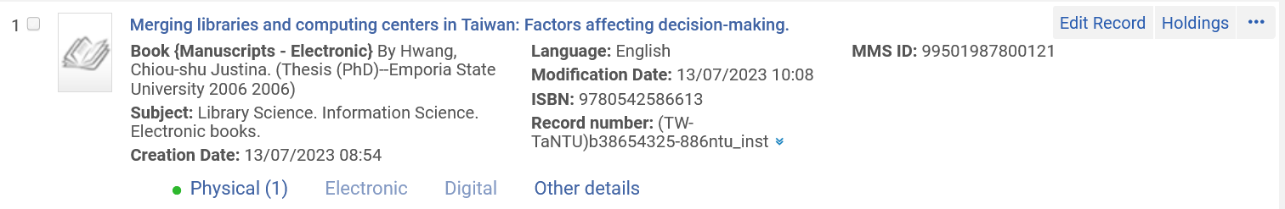
Viewing the Bibliographic Rank
Let’s take a look at title “Merging libraries and computing centers in Taiwan: Factors affecting decision-making.”

Slide 9
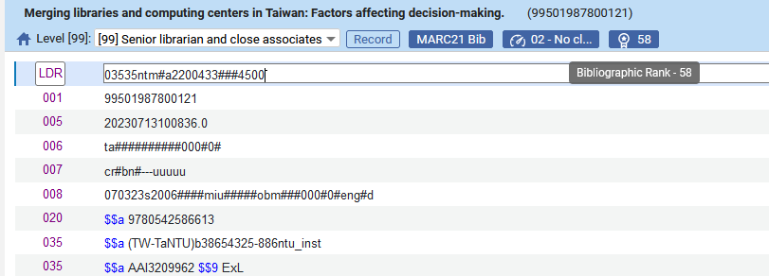
Viewing the Bibliographic Rank
Here is the Bibliographic Rank in the Metadata Editor

Slide 10
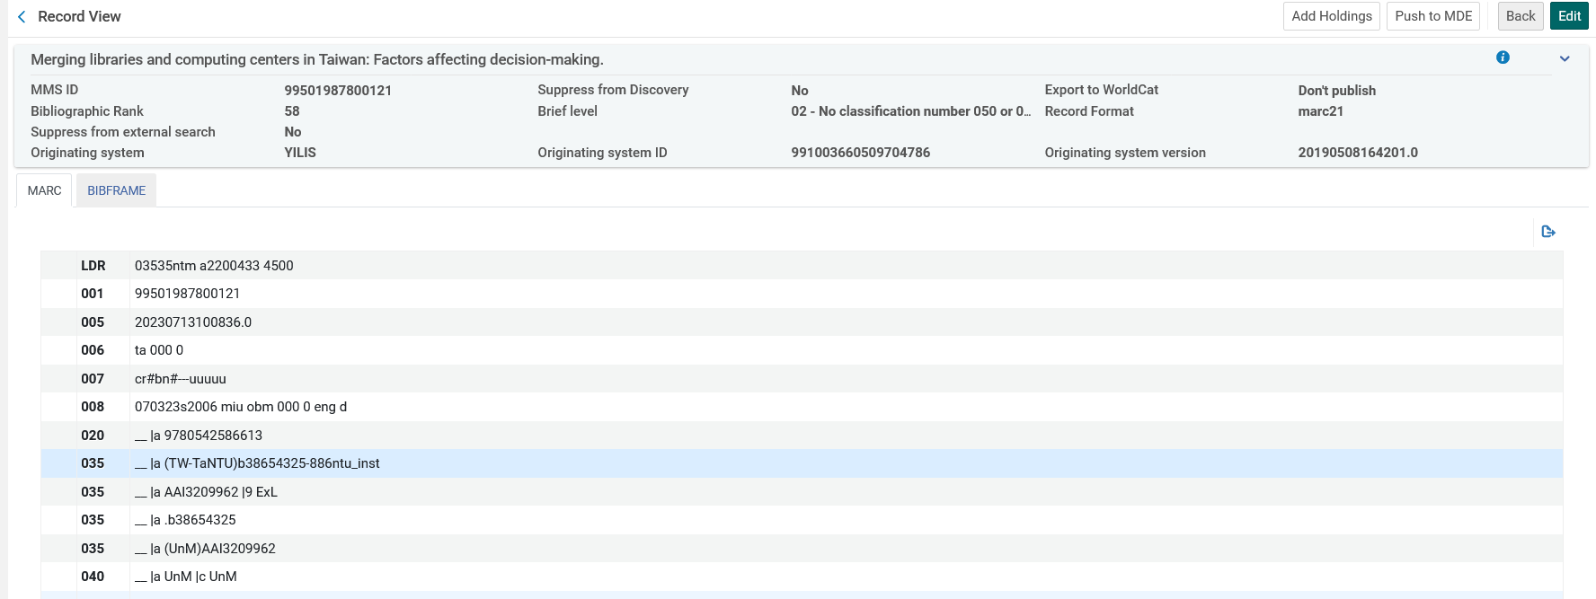
Viewing the Bibliographic Rank
Here is the Bibliographic Rank in the Record View

Slide 11
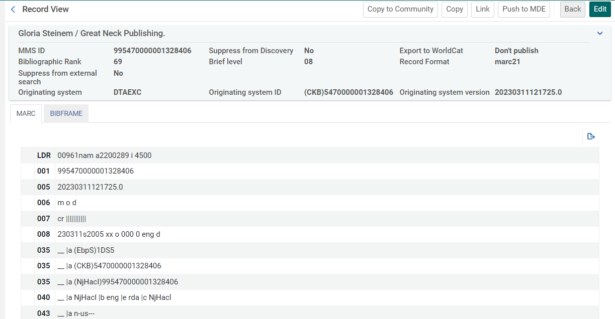
Viewing the Bibliographic Rank
Here is the Bibliographic Rank in the Record View for a CZ record.

Slide 12
Searching and retrieving by Bibliographic Rank

Slide 13
Searching and retrieving by Bibliographic Rank
As the bibliographic rank is higher it means that the record is of a higher quality.
As the bibliographic rank is lower it means that the record is of a lower quality.
An institution may wish to search for records with a low bibliographic rank in order to improve those records.

Slide 14
Searching and retrieving by Bibliographic Rank
The ability to search by Bibliographic Rank, like other search indexes, is defined at “Configuration > Resources > Search Configuration > Search Indexes”.
Below the Index Code “mms_qualityScore”, which corresponds to the index “Bibliographic Rank”, is defined to display in advanced search.
This is the default.

Slide 15
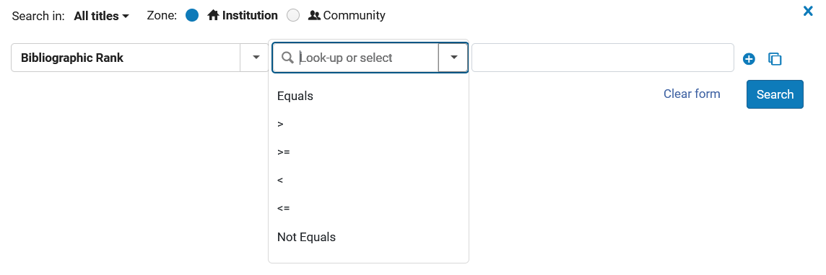
Searching and retrieving by Bibliographic Rank
The Bibliographic Rank can be searched via a wide range of operators

Slide 16
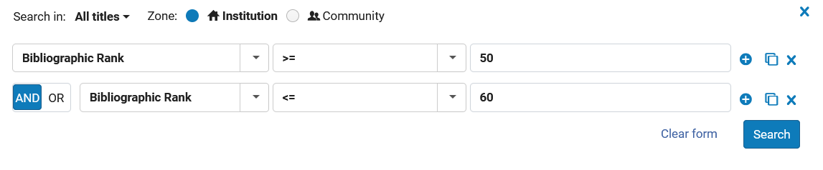
Searching and retrieving by Bibliographic Rank
Here for example, we are searching for all records with a Bibliographic Rank between 50 and 60 (greater than or equal to 50 and less than or equal to 60)

Slide 17
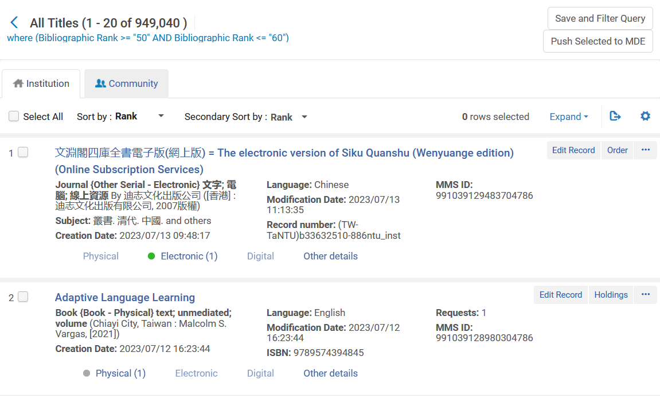
Searching and retrieving by Bibliographic Rank
Let’s take a look at the first result

Slide 18
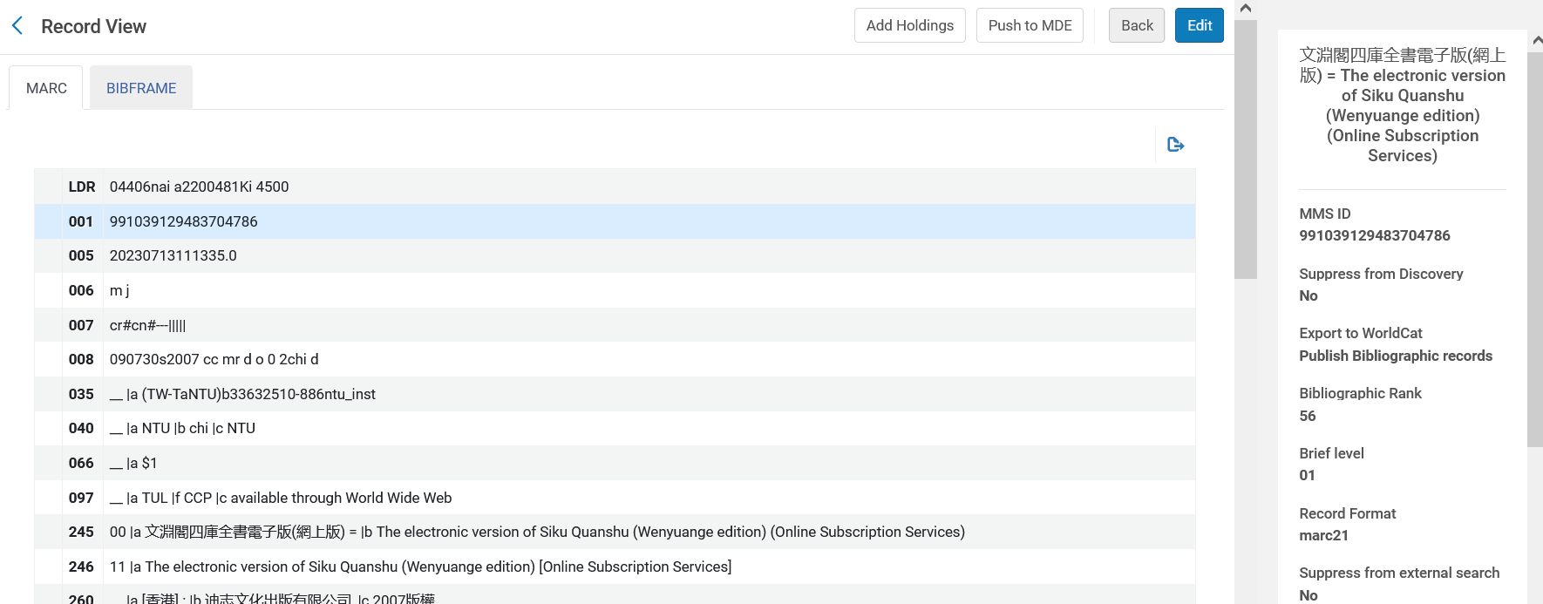
Searching and retrieving by Bibliographic Rank
The Bibliographic Rank is 56 (which is between 50 and 60)

Slide 19
Searching and retrieving by Bibliographic Rank
Let’s take a look at the second result

Slide 20
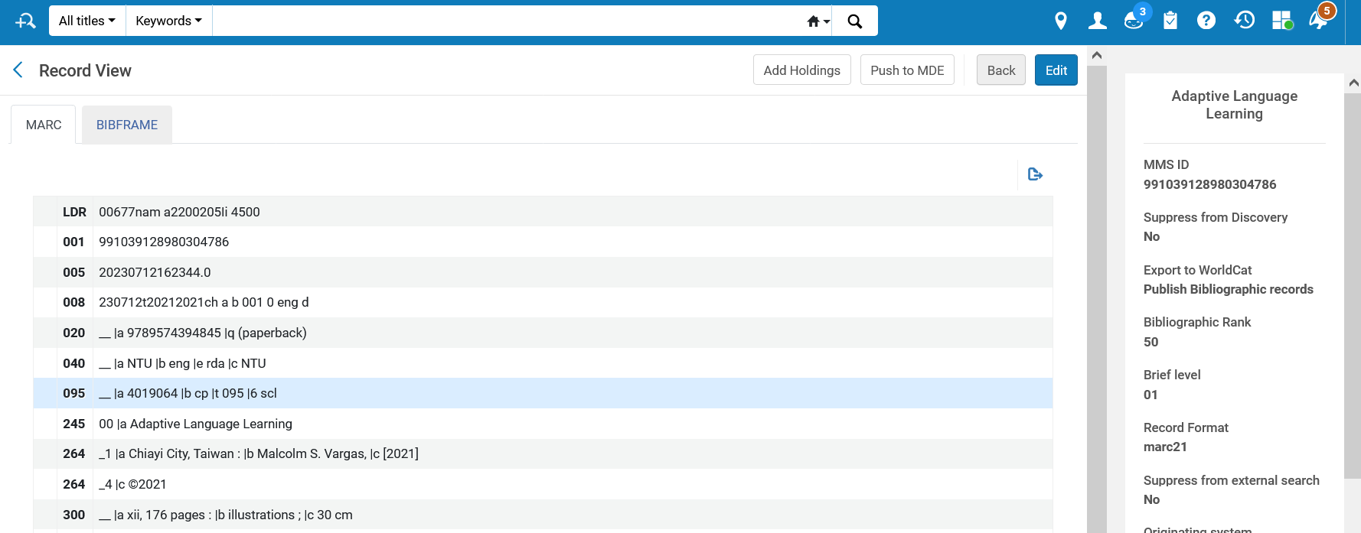
Searching and retrieving by Bibliographic Rank
The Bibliographic Rank is 50 (which is between 50 and 60)

Slide 21
How the Bibliographic Rank is determined

Slide 22
How the Bibliographic Rank is determined
The Bibliographic Rank is determined by the Bibliographic Rank Algorithm.
It checks the records on two levels:
  Breadth
  Depth
The total score is breadth score + depth score.
Additionally, points can be removed from the total score based on validations and field accuracies (as we will soon see).

Slide 23
How the Bibliographic Rank is determined
Level 1 - Breadth:
  The focus here is on coverage: Fields are grouped into categories and where a record has any one of the fields in a category it is given a score according to the importance of the category.
    LOW importance gives 1 point
    MEDIUM importance gives 3 points
    HIGH importance gives 7 points
For example
  Subjects category has high importance, so it is assigned a score of 7.
  Canceled identifiers category is less important, so it has a score of only 1. There are 28 categories. The full list is described at the Bibliographic Rank Algorithm.

Slide 24
How the Bibliographic Rank is determined
Level 2 - Depth:
  The second focus is on depth.
  For example, rather than just checking that there is a 6XX field, attention is paid to how many 6XX fields are included.
Depth is relevant only for some of the categories.
  When a record has such a category, the fields in the category are counted.
  The number of fields is the depth score of the category.
  There is a limit to the number of fields counted for depth. For example, the depth limit for category “Subjects” is 15. Therefore, even if the record has 16 “Subjects”, the depth score will be 15.

Slide 25
How the Bibliographic Rank is determined
The breadth and depth is described in the Bibliographic Rank Algorithm and the introductory section appears on the next slide.
For “Breadth” fields are given an Importance of “Low”, “Medium” and “High”.
  Low = 1 point
  Medium = 3 points
  High = 7 points

Slide 26
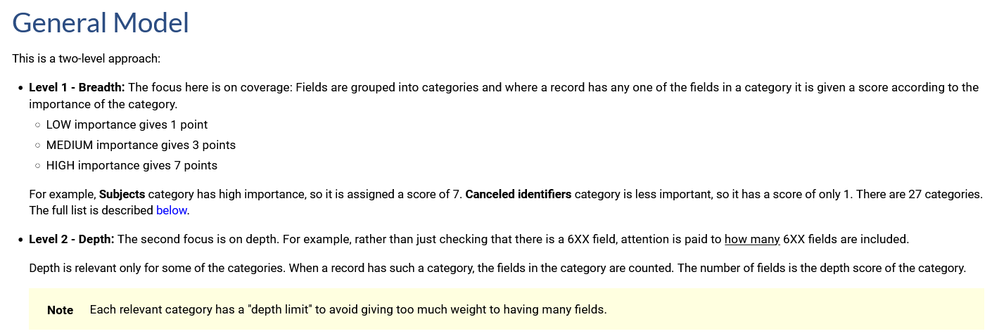
How the Bibliographic Rank is determined

Slide 27
How the Bibliographic Rank is determined
In addition to giving points for breadth and depth, points can be deducted for validations and accuracy.
These are described in the Bibliographic Rank Algorithm and appear on the next slide.

Slide 28
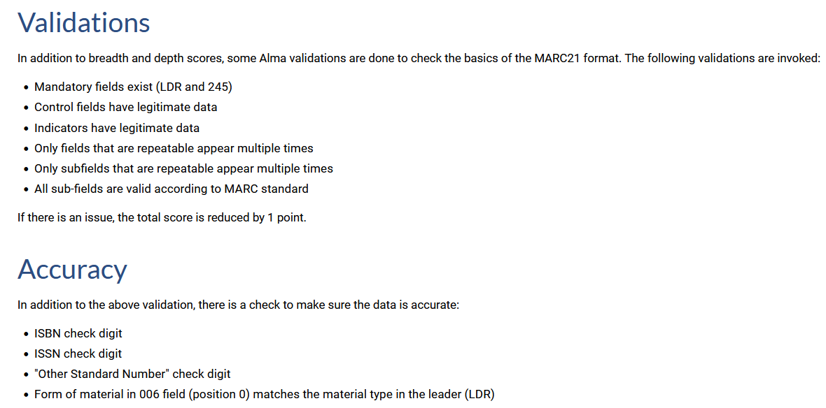
How the Bibliographic Rank is determined

Slide 29
The sample record we will use

Slide 30
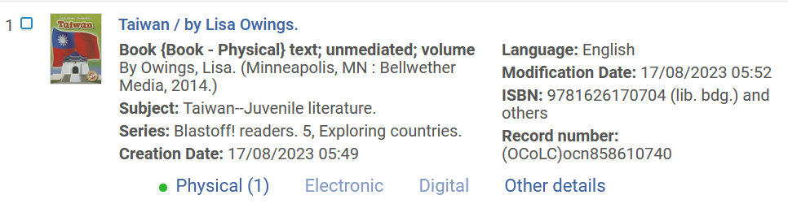
The sample record we will use
Let’s take a look at “Taiwan / by Lisa Owings” (MMS ID: 99503287800121).
It has a Bibliographic Rank of 88.

Slide 31
A real-life example of how the Bibliographic Rank is determined

Slide 32
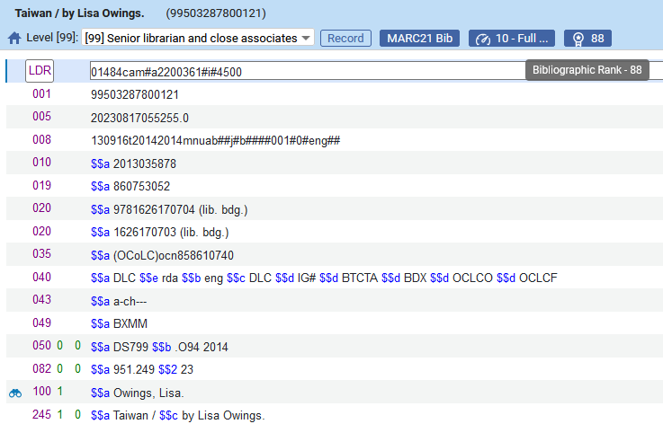
A real-life example of how the Bibliographic Rank is determined
It has a Bibliographic Rank of 88.

Slide 33
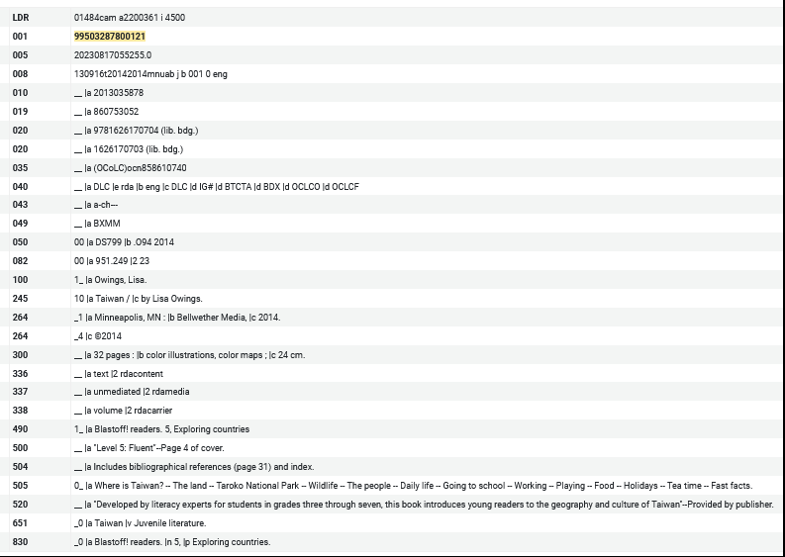
A real-life example of how the Bibliographic Rank is determined
This is the complete record which we will now start analyzing

Slide 34
A real-life example of how the Bibliographic Rank is determined

Slide 35
A real-life example of how the Bibliographic Rank is determined
The record has "Leader" field so it has a breadth importance HIGH which gives it 7 points.
Total 7 (Breadth = 7, Depth = 0)
This field does not get points for depth

Slide 36
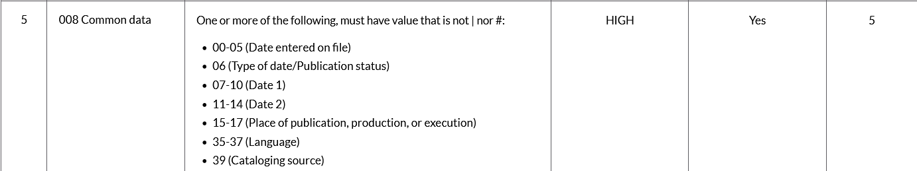
A real-life example of how the Bibliographic Rank is determined
The record has "008 Common data" field so it has a breadth importance HIGH which gives it 7 points.
It also has all of the following (but can only get 5 points instead of 7 even though it has all 7 values because the depth limit is 5)
  00-05 (Date entered on file)
  06 (Type of date/Publication status)
  07-10 (Date 1)
  11-14 (Date 2)
  15-17 (Place of publication, production, or execution)
  35-37 (Language)
  39 (Cataloging source)
Total 12 (Breadth = 7, Depth = 5)

Slide 37
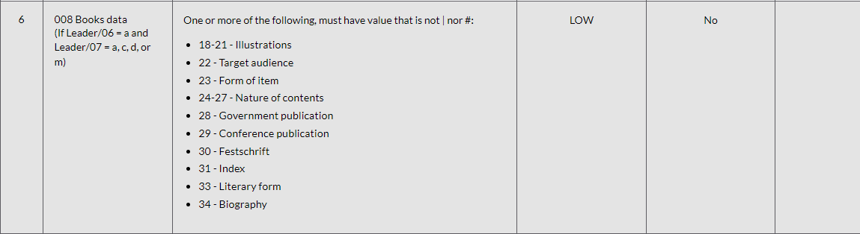
A real-life example of how the Bibliographic Rank is determined
The record has "008 Books data" so it has a breadth importance LOW which gives it 1 point.
Total 1 (Breadth = 1, Depth = 0)
This field does not get points for depth

Slide 38
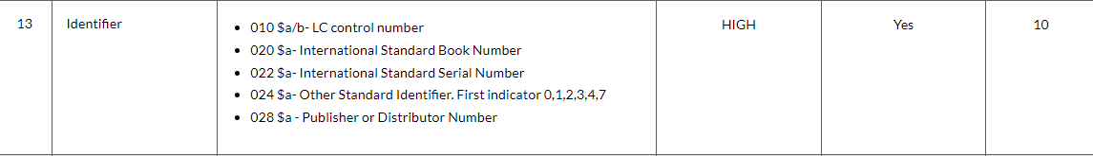
A real-life example of how the Bibliographic Rank is determined
The record has one 010 "Identifier" field and two 020 "Identifier" fields, so it has a breadth importance HIGH which gives it 7 points.
It also gets 1 point for depth for each of the Identifier fields, so that is 3 (1 for each Identifier field)
Total 10 (Breadth = 7, Depth = 3)

Slide 39
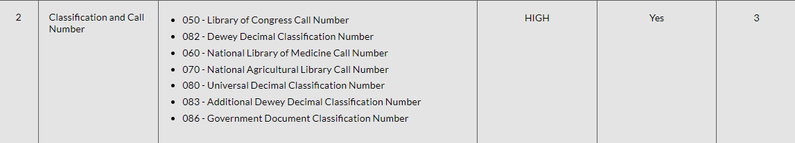
A real-life example of how the Bibliographic Rank is determined
The record has two "Classification and Call Number" fields. It has one 050 and one 082. Therefore, it has a breadth importance HIGH which gives it 7 points.
It also gets 1 point for depth for each of the "Classification and Call Number" fields, so that is 2
Total 9 (Breadth = 7, Depth = 2)

Slide 40
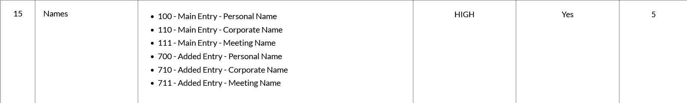
A real-life example of how the Bibliographic Rank is determined
The record has one "Names" field. which is a 100 field. Therefore, it has a breadth importance HIGH which gives it 7 points.
The record has one 100 field so it gets 1 points for depth
Total 8 (Breadth = 7, Depth = 1)

Slide 41
A real-life example of how the Bibliographic Rank is determined
The record has a 245 "Title" field. Therefore, it has a breadth importance HIGH which gives it 7 points.
Total 7 (Breadth = 7, Depth = 0)
This field does not get points for depth

Slide 42
A real-life example of how the Bibliographic Rank is determined
The record has a "Publication details" field. Therefore, it has a breadth importance HIGH which gives it 7 points.
Total 7 (Breadth = 7, Depth = 0)
This field does not get points for depth

Slide 43
A real-life example of how the Bibliographic Rank is determined
The record has the following "Physical description" fields: 300, 336, 337 and 338. Therefore, is has a breadth importance MEDIUM which gives it 3 points.
The record has one four description fields so for depth it gets 4 points.
Total 7 (Breadth = 3, Depth = 4)

Slide 44
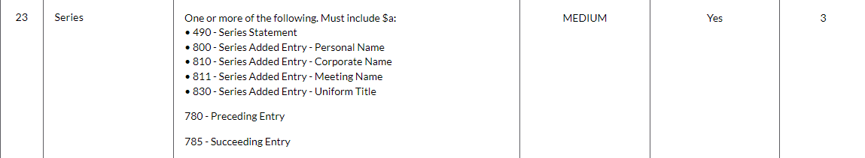
A real-life example of how the Bibliographic Rank is determined
The record has the following “Series" fields: 490 and 830. Therefore, is has a breadth importance MEDIUM which gives it 3 points.
The record has one two series fields so for depth it gets 2 points.
Total 5 (Breadth = 3, Depth = 2)

Slide 45
A real-life example of how the Bibliographic Rank is determined
The record has one 504 “Bibliography” field. Therefore, it has a breadth importance LOW which gives it 1 point.
Total 1 (Breadth = 1, Depth = 0)
This field does not get points for depth

Slide 46
A real-life example of how the Bibliographic Rank is determined
The record has one 505 “Table of Content” field. Therefore, it has a breadth importance MEDIUM which gives it 3 points.
Total 3 (Breadth = 3, Depth = 0)
This field does not get points for depth

Slide 47
A real-life example of how the Bibliographic Rank is determined
The record has one 520 “Summary” field. Therefore, it has a breadth importance MEDIUM which gives it 3 points.
Total 3 (Breadth = 3, Depth = 0)
This field does not get points for depth

Slide 48
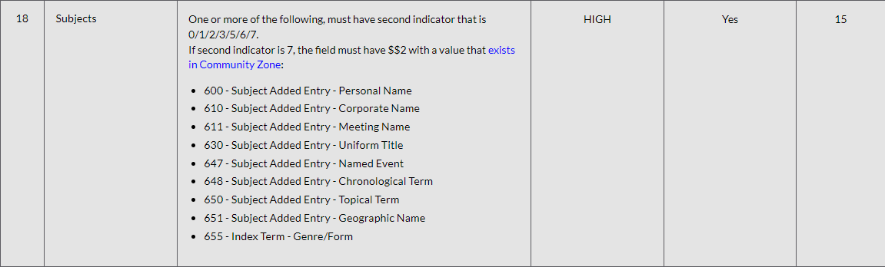
A real-life example of how the Bibliographic Rank is determined
The record has one 651 “Subject” field. Therefore, it has a breadth importance HIGH which gives it 7 points.
The one field gives it a depth of 1 point.
Total 8 (Breadth = 7, Depth = 1)

Slide 49
A real-life example of how the Bibliographic Rank is determined
So … we have a total of 88 points:
"Leader" = 7
"008 Common Data" = 12
"008 Books Data" = 1
"Identifier" = 10
"Classification and Call Number" = 9
"Names" = 8
"Title" = 7
"Publication details" = 7
"Physical description" = 7
"Series" = 5
"Bibliography" = 1
"Table of Content" = 3
"Summary" = 3
"Subject" = 8
-----------------------
Total – 88 points

Slide 50
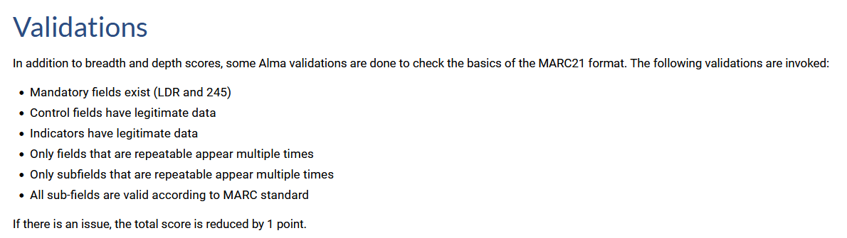
A real-life example of how the Bibliographic Rank is determined
We stated earlier that points can also be deducted based ion validations and accuracy, as described at Bibliographic Rank Algorithm.
Here is how points are taken away for Validations.

Slide 51
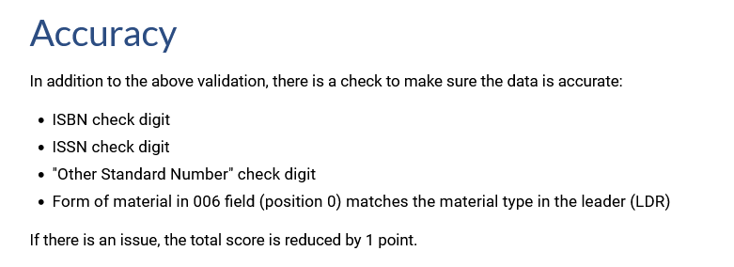
A real-life example of how the Bibliographic Rank is determined
Points are also taken away from records for accuracy as described at Bibliographic Rank Algorithm.

Slide 52
A real-life example of how the Bibliographic Rank is determined
On the next slide we will see that we have added two errors to the record in order to test the deduction of points.
We added an invalid character in the ISBN so that the “check digit” will detect an accuracy error.
We added an invalid first indicator to one of the 264 fields so that there will be a validation error.
One point should be taken off for each error, changing the Bibliographic Ranking from 88 to 86

Slide 53
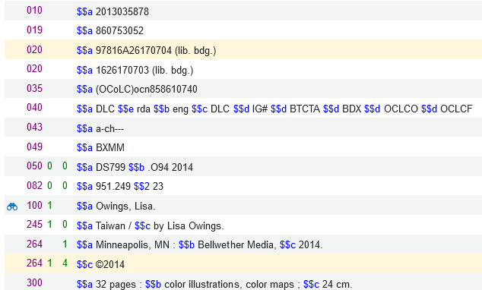
A real-life example of how the Bibliographic Rank is determined
Accuracy problem: We added an invalid character in the ISBN so that “check digit” will know it is wring and reduce one point.
Validation problem: We added an invalid first indicator to the 264.

Slide 54
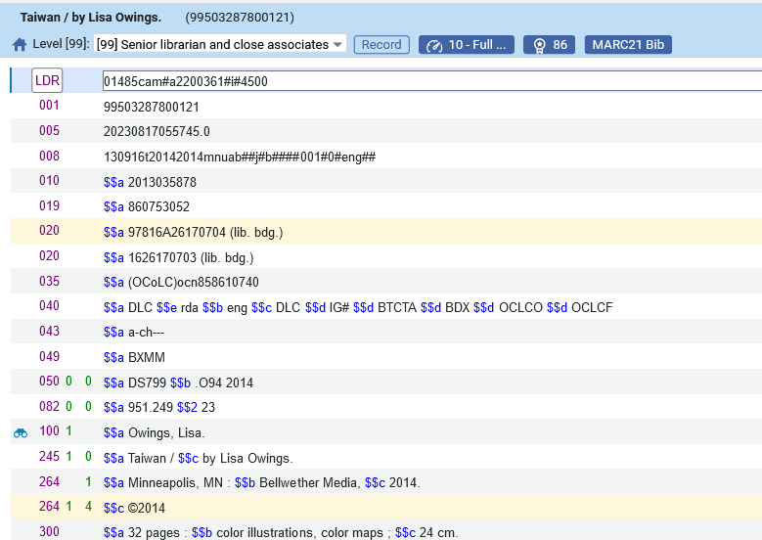
A real-life example of how the Bibliographic Rank is determined
After saving the record with the two errors two points were deducted and the rank went from 88 to 86

Slide 55
Future plans for Community Zone Collections

Slide 56
Future plans for Community Zone Collections
As per NERS Candidate #7069 and Ideas Exchange request, the Bibliographic Rank will be used to Provide MARC record quality measures for CZ collections.
This is tentatively planned for November 2023.
This will be done by having:
  The total Avg rank for all the portfolios in the collection
  Distribution by rank quality percent determined as follows:
    Low - 0-39
    Med 40-79
    High 80-150
See example on next slide.

Slide 57
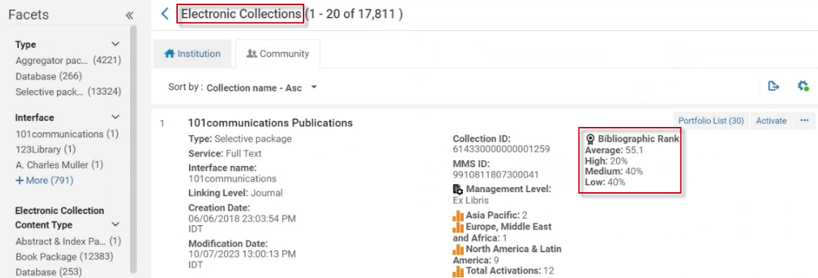
Future plans for Community Zone Collections
In this collection
The average bibliographic rank for all portfolios in the collection is 55.1
20% of the portfolios have a bibliographic rank of 80 or higher.
40% of the portfolios have a bibliographic rank between 40 and 79.
40% of the portfolios have a bibliographic rank of 39 or lower.

Slide 58
Future plans for Alma Analytics

Slide 59
Future plans for Alma Analytics
The Bibliographic Rank is planned to be added to Alma Analytics.
The Bibliographic Rank will be added to the shared “Bibliographic Details” folder.

